Slide 1
Last week

Slide 2
LAST WEEK’s HOMEWORK
PLAY Increpare’s Slave of God seizure warning!!
READ Art Games chapter from Works of Game (Sharp)
READ Rock Paper Shotgun - Photorealism is Crucial
READ Video Games Can Never be Art (Roger Ebert)
WRITE
What is your reaction to Slave of God?
Can games be art?
Do pretty graphics matter?
Should games be realistic?
etc.

Slide 3
Warm seat discussions!
wait, what?

Slide 4
Half the class moves to the next seat every 2 minutes!

Slide 5
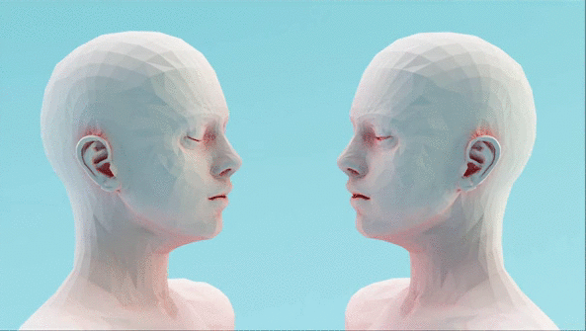
GAMES AS AN
EXPRESSIVE
MEDIUM

Slide 6
STYLE is IMPORTANT

Slide 7
STYLE is SUBSTANTIVE

Slide 8
REALISM can be more than just PHOTOREALISM

Slide 9
Essentialize experience
how can you find the right metaphors?
Notes:
truth of the subjective experience

Slide 10
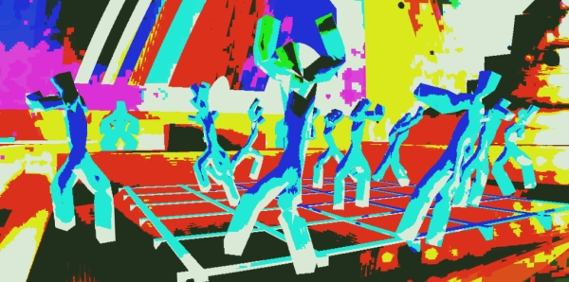

Slide 11
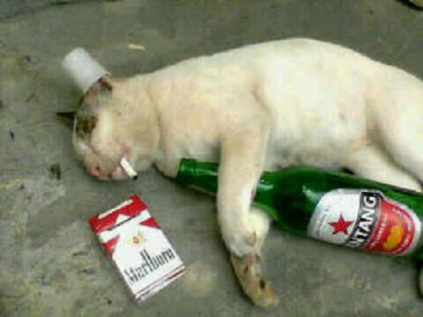
Wtf happened last night?
All I remember...
vivid colors, deep house beats, everything spinning, human connection… what was their name again?

Slide 12
COMMUNICATING EMOTION

Slide 13
Establishing a unique experience
and forgetting that you’re playing a game

Slide 14
GAME
FEEL

Slide 15
Game feel as the experiential sensation of a game

Slide 16
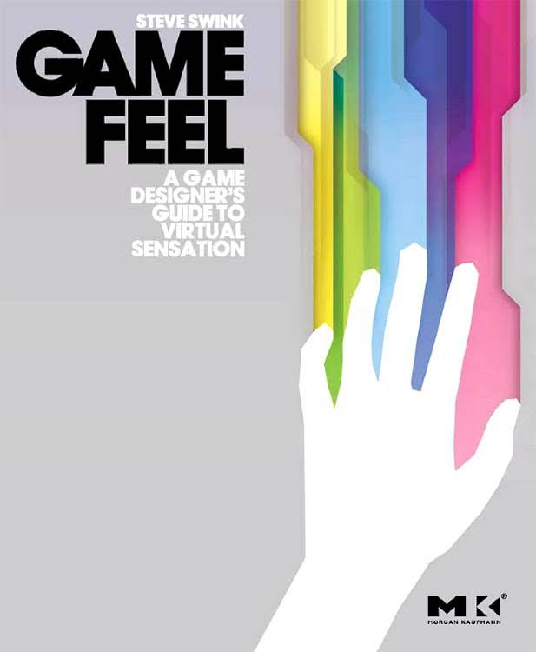
Game Feel
What does Tekken feel like?
Pac-man?
Katamari Damacy?
book link

Slide 17
“The five most common experiences of game feel are:
● The aesthetic sensation of control
● The pleasure of learning, practicing and mastering a skill
● Extension of the senses
● Extension of identity
● Interaction with a unique physical reality within the game”

Slide 18
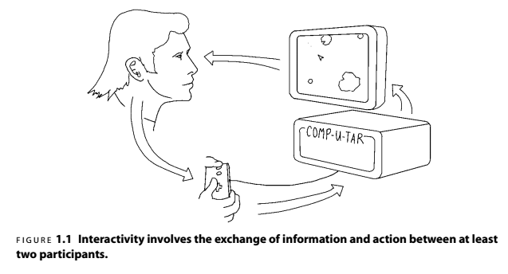
Notes:
simple feedback loop

Slide 19
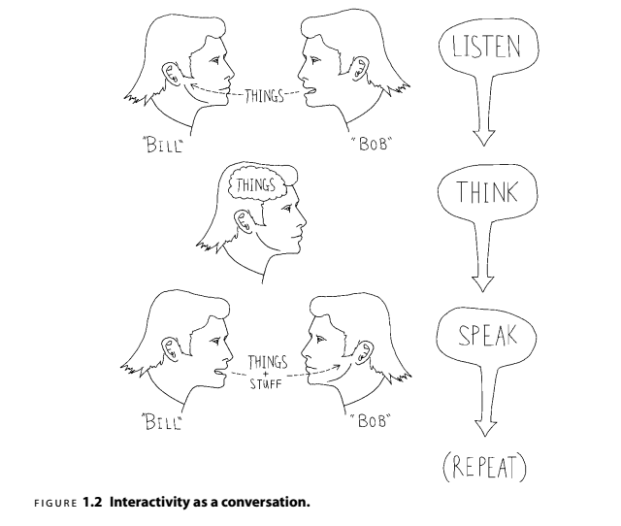
Notes:
The conversation in Figure 1.2begins when one participant, Bob, speaks. The
other participant, Bill, listens to what was said, thinks about it, formulates a response
and speaks in return. Now it’s Bob’s turn to listen, think and speak, and so on. In
Crawford’s model, a computer replaces one of the participants, “ listening ”to the
player’s input via the input device, thinking by processing that input and changing
system state and “ speaking ”via the screen and speakers ( Figure 1.3 ).

Slide 20
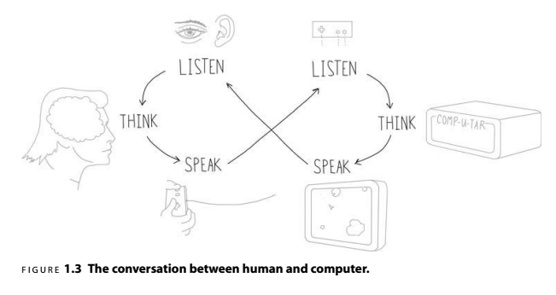
Notes:
quickest way to break a game, unintuitive controls

Slide 21
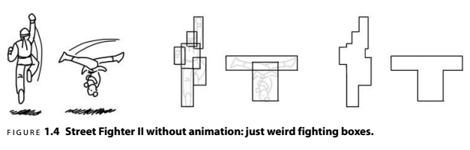

Slide 22
Control Interface Evolution
evolving the illusion

Slide 23


Slide 24
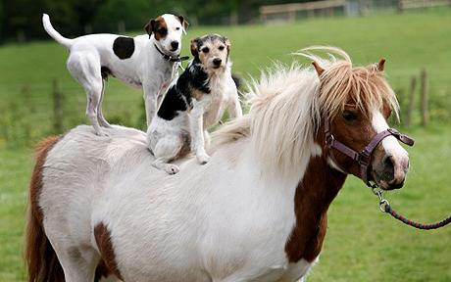
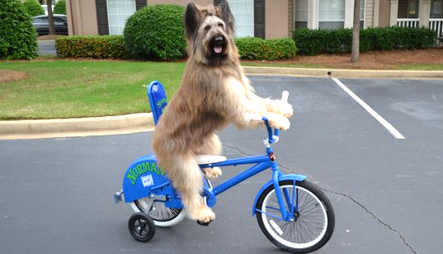

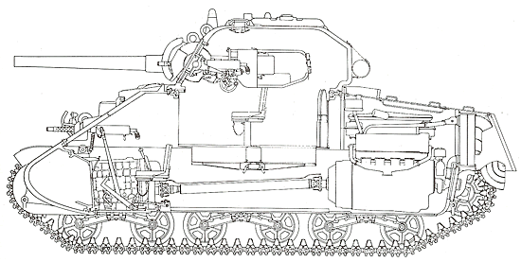
vs
vs
vs
vs

Slide 25

you are the car
“that @#$% hit me!”

Slide 26

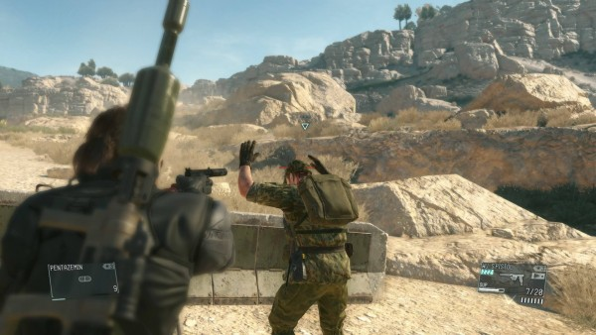
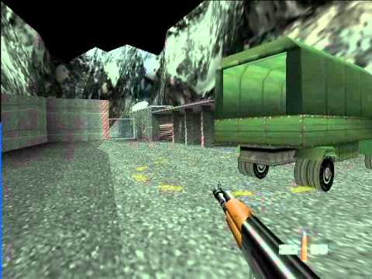
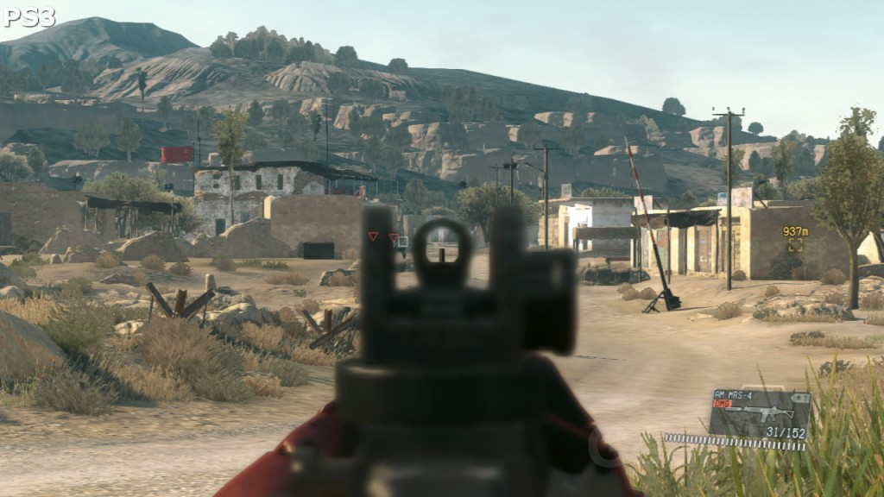
vs

Slide 27
fluid, harmonious
and natural

Slide 28
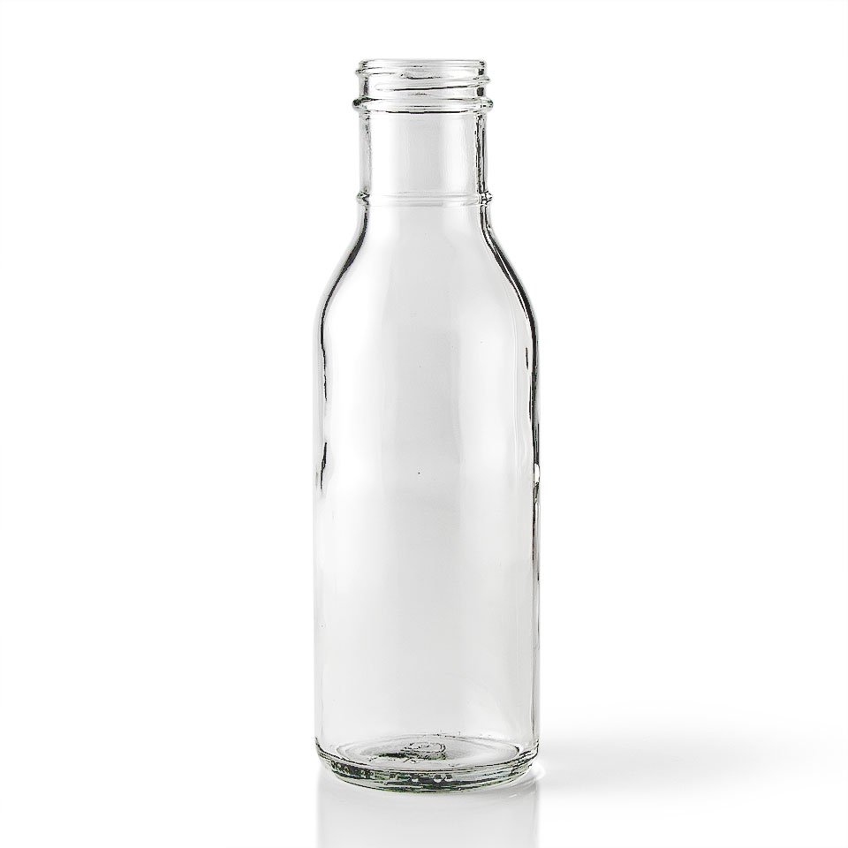

Make your games juicy!
subtle details make all the difference

Slide 29
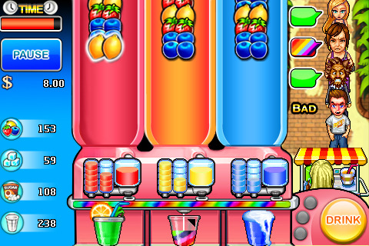

Slide 31
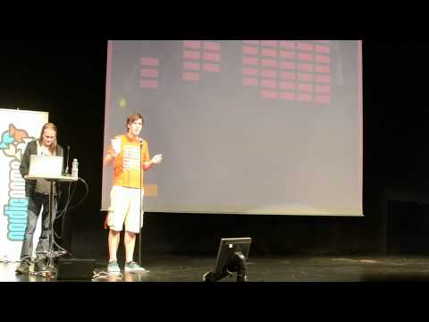

Slide 32
HOMEWORK

